Slide 1
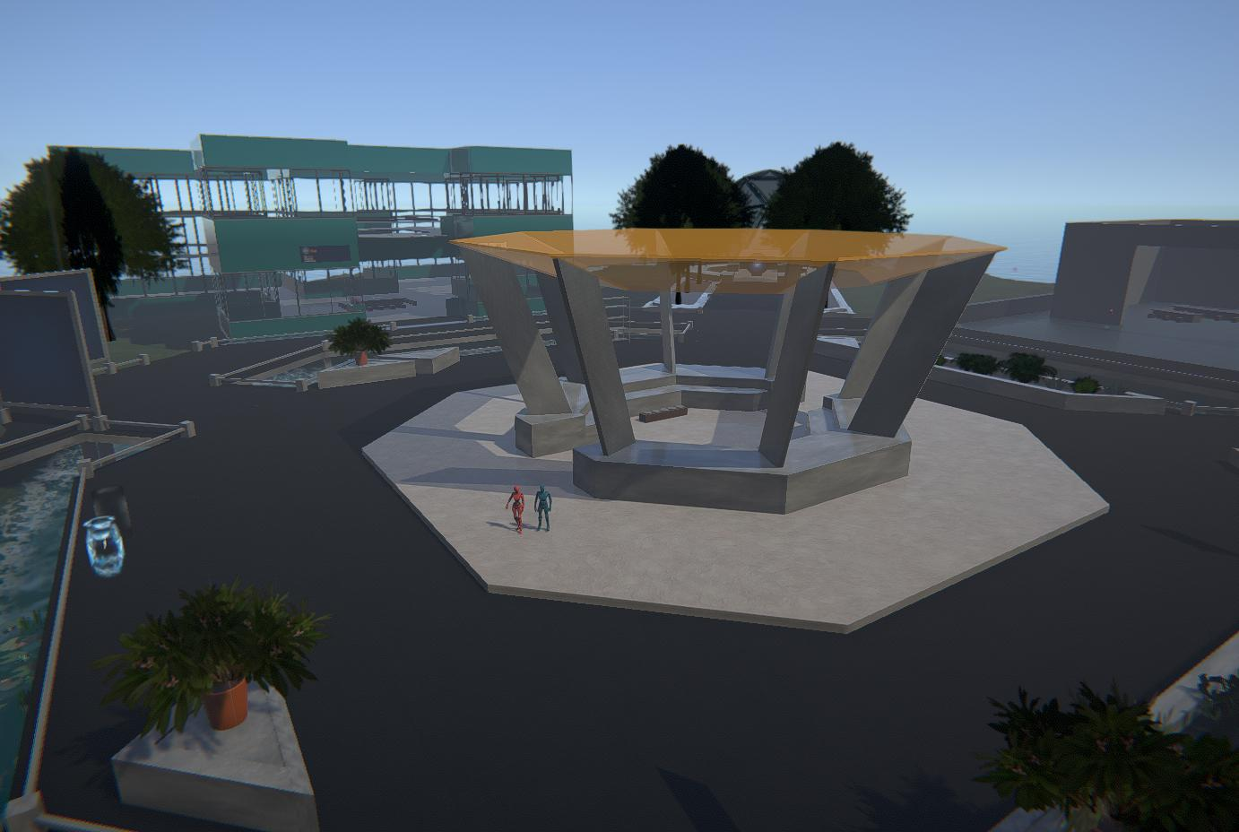
OAR Converter: Using OpenSimulator and Unity as a Shared Development Environment for Social Virtual Reality Environments
Fumikazu Iseki
Tokyo Univ. of Info. Sci., Dept. of Informatics, Japan
Daichi Mizumaki
Tokyo Univ. of Info. Sci., Dept. of Informatics, Japan
Austin Tate
AIAI, School of Informatics, University of Edinburgh, UK
Kohei Suzuki
The Daiichi Information Systems Co., Ltd, Japan

Slide 2
OAR Converter – Purpose
OAR Converter can take an OpenSimulator Archive (OAR) and from it create textures, meshes and terrain suitable to import into Unity3D.
OAR Converter goes from an OpenSimulator Archive (OAR) to Collada (.DAE) files for use in Unity3D.
The software was developed by Fumi Iseki and his colleagues at the Network Systems Laboratory of Tokyo University of Information Sciences (TUIS) in Japan with support from Austin Tate at the University of Edinburgh.
OAR Converter can run on Linux and Windows and source code is available.
For convenience a version with Windows UI is also available as a ready to run package.

Slide 3
OAR Converter – Process
OpenSim
Unity
OAR
File
Collada
.DAE File
Editor Extension
(Shader)
OAR Converter
SelectOARShader

Slide 4
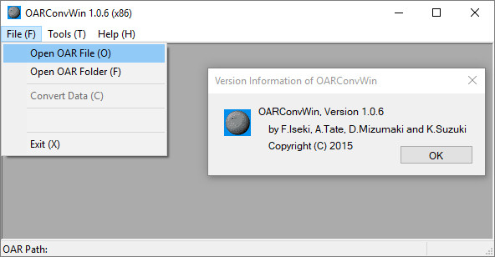

Slide 5
OAR Converter – Quick Start
Place your OpenSim OAR file in a suitable directory. Using defaults, the conversions will be placed in separate directories in this same directory with names based on the OAR file name prefixed by OAR_ and DAE_
Run the OAR Converter and using “File” -> “Open OAR File” select the OAR file you wish to convert. This will create a directory called OAR_ with the unpacked contents of the OAR file ready for conversion.
Now select “File” -> “Convert Data” from the OAR Converter File menu. This will create a directory called DAE_ with the converted content in it.
The DAE_ directory created will contain the DAE/Collada objects for the conversion which have colliders (are solid) and one special DAE/Collada object for the terrain (named the same as the OpenSim region name). It will also have sub-directories for all Textures and for the Phantoms (objects with no collider).

Slide 6
Import to Unity3D – Quick Start
In a Unity project, add a special “Shader” Editor/SelectOARShader.cs which handles the import of the textures and material properties for imported objects.
In your Unity project add an empty game object at 0,0,0. You could name it the same as your OpenSim region name for convenience.
Drag the DAE_ folder in its entirety onto the Unity “Project” (Assets) panel.
Select all the objects in the top level of this directory except the Textures and Phantoms sub-directories and drag them onto the empty game object in the Unity “Hierarchy” panel.
Create another empty game object at 0,0,0 under the previous one. You could name it “Phantoms” for convenience.
Select all the objects in the Phantom directory and drag them onto the “Phantoms” game object in the Unity “Hierarchy” panel.
Optionally add a water layer at 0,0,0 using standard Unity assets.

Slide 7
Issues that may arise
Take care to include the customised Editor/SelectOARShader.cs in the project assets.
You may see a warning from Unity about a mesh having more then 64K vertices or triangles indicated on loading the assets in Unity. The converted OpenSim terrain mesh has 256x256x2 triangles, but Unity itself splits larger meshes into smaller components to address this.
During conversion the OAR Converter may report a number of errors related to texture conversion. The OAR Converter tries a number of JPEG2K libraries to do its best for conversion, but some still cannot be converted.
The OAR Conversion process does not bring across any active scripting, particle systems (for smoke, fire, etc.) or special light sources. You need to add these again into a Unity project.

Slide 8
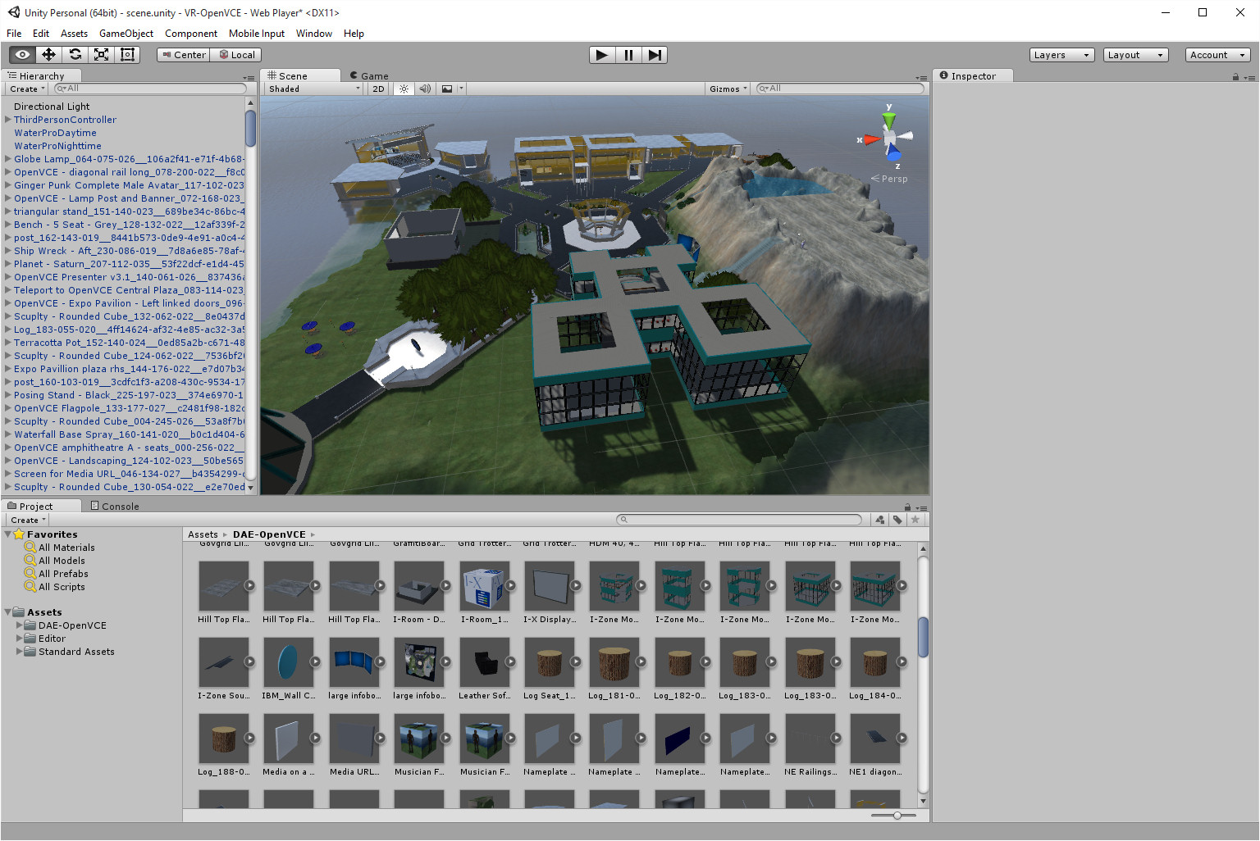

Slide 9
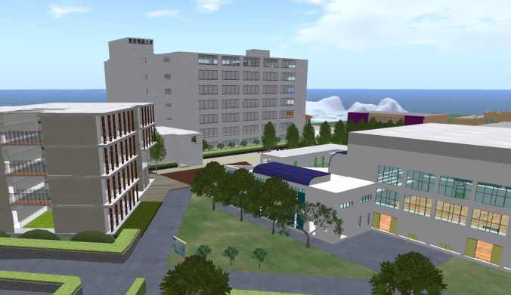
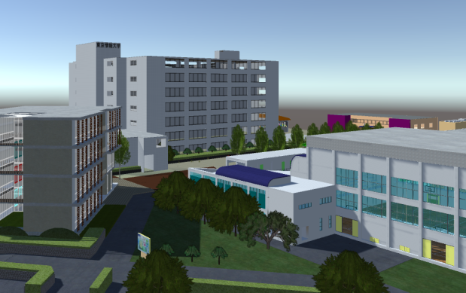

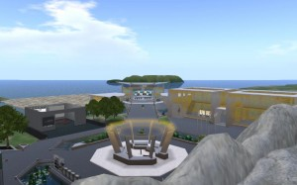

Slide 10
Visiting the OAR Converted Region
You can immediately look at the converted region content by adding a suitable “ThirdPersonController” and avatar such as the Unity “Ethan” standard asset.
The OAR Converter distribution includes the free Unity Japan “UnityChan” character.
Once available the Unity content can be published and used in any Unity project including via Unity-based multi-user virtual worlds such as Sinespace.

Slide 11
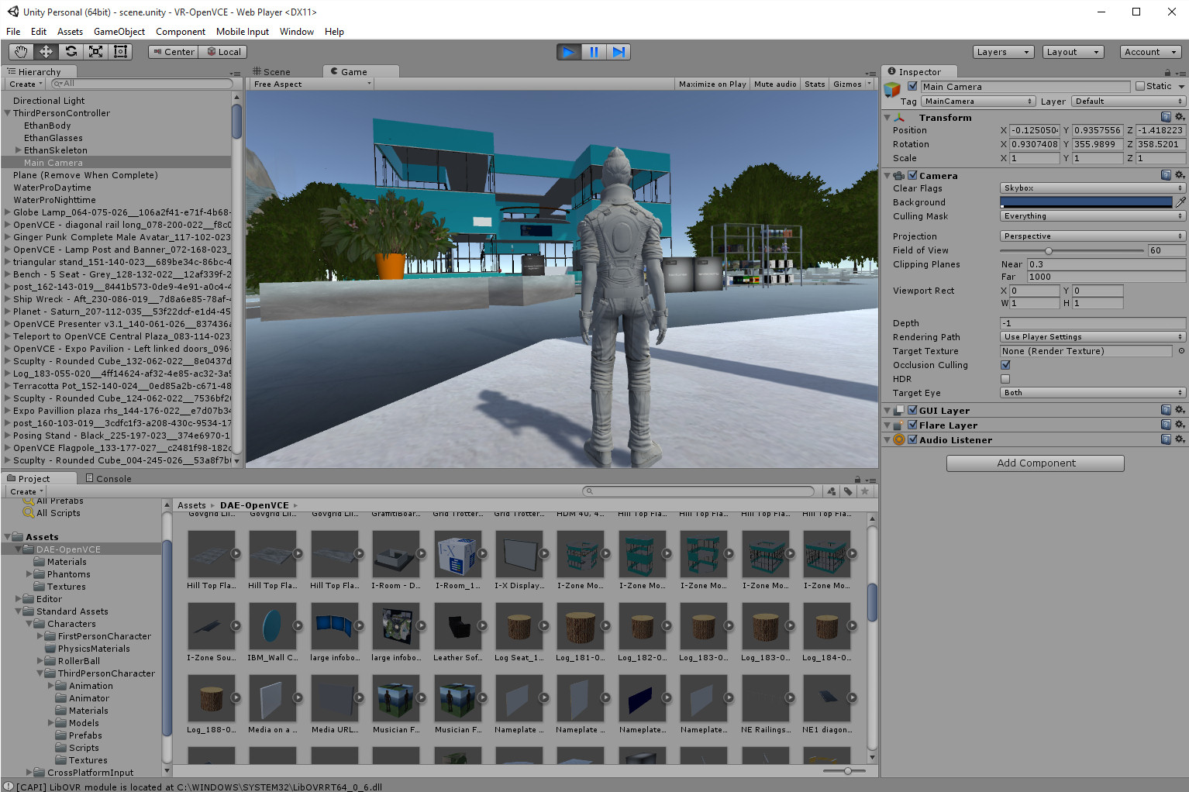

Slide 13
OAR Converter – Use with Sinespace
Sinespace is a Unity-based multi-user virtual world platform which allows users/creators to add their own regions and experiences.
Sinespace supports WebGL/Browser, desktop, mobile platforms and VR.
OAR Converted regions or extracts from them can easily be used in Sinespace, but there is an issue with many repeated textures and materials due to the way that OAR Converter encodes visual properties in texture/material names leading to repeats of the (potentially large) texture files in the Unity project.
Adam Frisby, himself an early developer of OpenSim, has provided a useful tool in the Unity Sinespace menu that allows for “OAR material Cleanup” which can be used before a Unity/OAR Converted Sinespace region is uploaded and which significantly reduces the number of repeated texture files needed.
Vue – Virtual University of Edinburgh – 12 regions from Second Life/OpenSim brought over and moved onto the original 256mx256m grid relative positions.

Slide 16
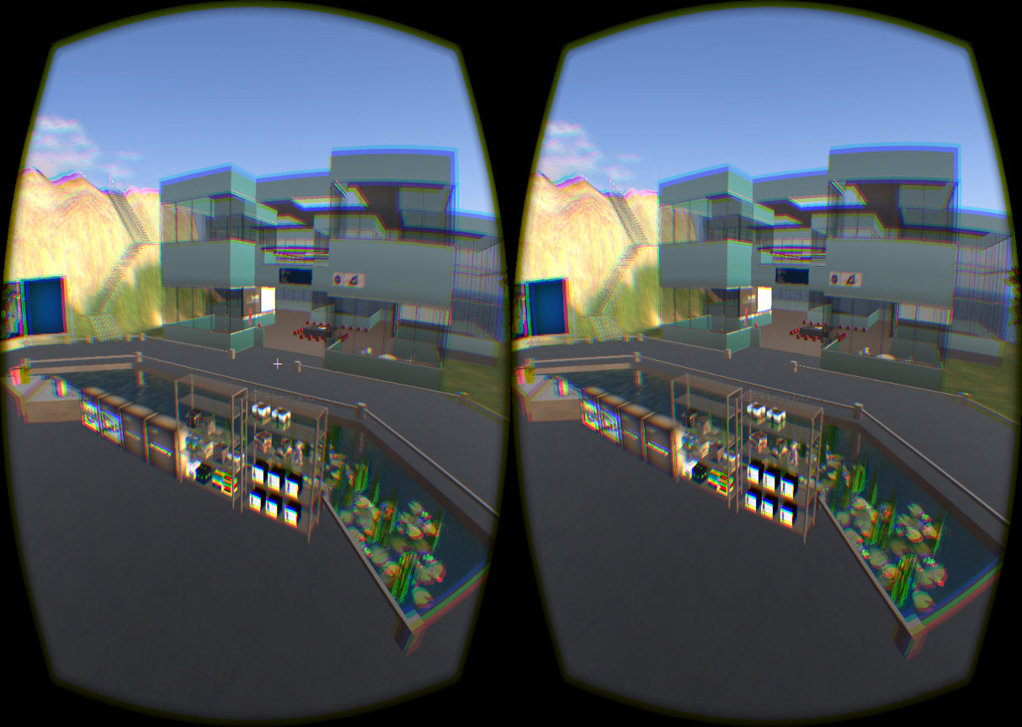

Slide 17
OAR Converter – License
Flexible – any use with attribution
OAR Converter © 2014-2016 Fumi.Iseki, Austin Tate, D.Mizumaki and K.Suzuki
License (2016 11/19) – http://www.nsl.tuis.ac.jp/, All rights reserved.
Redistribution and use in source and binary forms, with or without modification, are permitted provided that the following conditions are met:
Redistributions of source code must retain the above copyright notice, this list of conditions and the following disclaimer.
Redistributions in binary form must reproduce the above copyright notice, this list of conditions and the following disclaimer in the documentation and/or other materials provided with the distribution.
Neither the name of the OAR Converter nor the names of its contributors may be used to endorse or promote products derived from this software without specific prior written permission.
Please respect the copyright of content providers when using OAR Converter.

Slide 18
OAR Converter – More Information
A web page with OAR Converter resources, quick start information and links is available at:
http://blog.inf.ed.ac.uk/atate/oar-conv/
The main distribution web page and more detailed information is available at the original TUIS site in Japan at:
http://www.nsl.tuis.ac.jp/xoops/modules/xpwiki/?OARConvWin

Slide 19
Virtual World Development Paths
Second Life
Second Inventory
Paint Shop Pro
Photoshop
OpenSim
FBX Exporter
2D Textures
OAR
OAR Converter
DAE
Unity
Collada DAE Mesh
3D Models
Cinema4D, Blender, 3D Studio Max
Sinespace
Other Unity-based MMOs
Development Tools
SmartFox Pro
Proton MMO
Conversion Tools
Virtual World Platforms

